Slide 1
物聯網實務 HW6
電機碩一 11278008 林佳慧
日期:2023/10/18

Slide 2
Exercise 6-1
Design a chat room

Slide 3
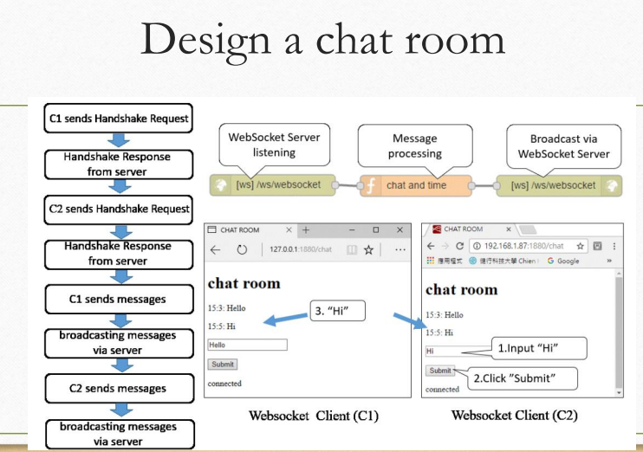

Slide 4
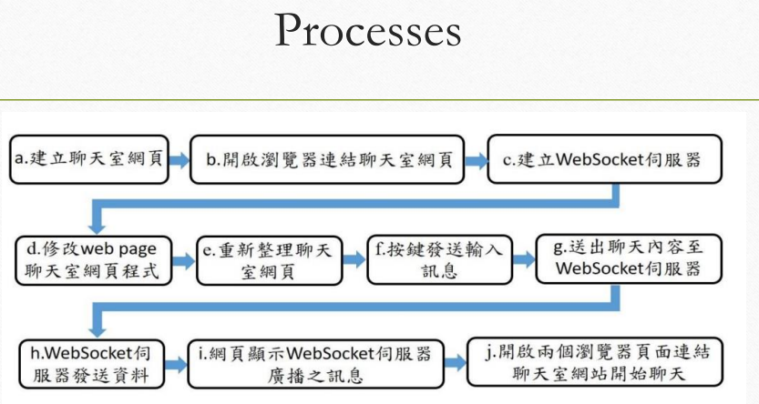

Slide 5
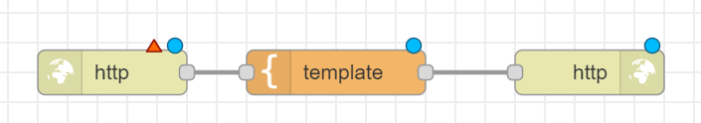
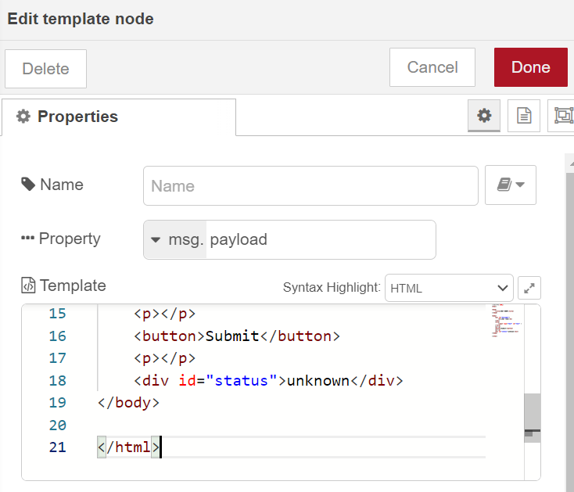
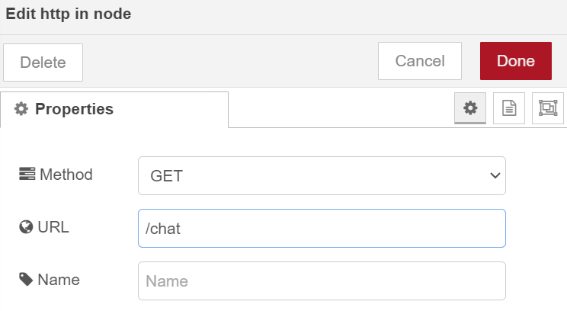
Step1: Create chat room HTML
network>http in
function>template
network> http response
1
6-1-1.txt

Slide 6
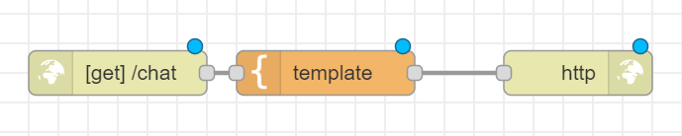
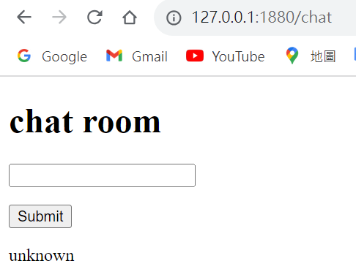
Chat Room API Flow
Chat room API
HTML
Response
Step2:open the chat room webpage
http://localhost:1880/chat

Slide 7
<!DOCTYPE HTML>
<html>
<head>
<title>CHAT ROOM</title>
</head>
<body>
<div id="messages"> <h1>chat room</h1> </div>
<form>
<input type="text" id="text" >
</form>
<p></p>
<button>Submit</button>
<p></p>
<div id="status">unknown</div>
</body>
</html>
id: "messages"
id: "text"
id: “status"

Slide 8
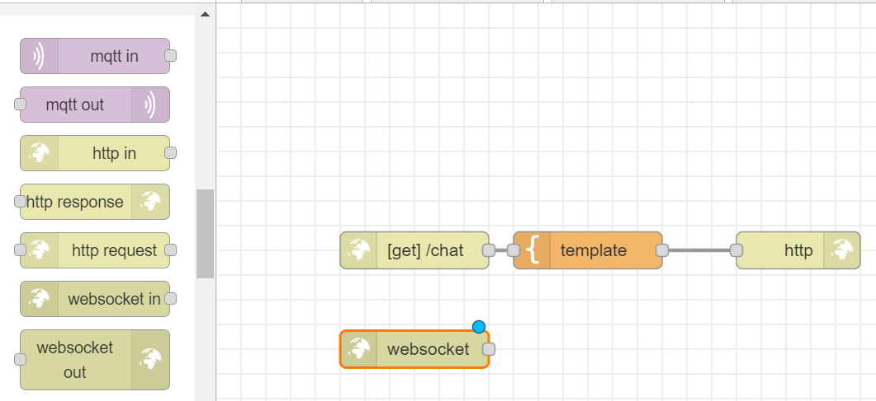
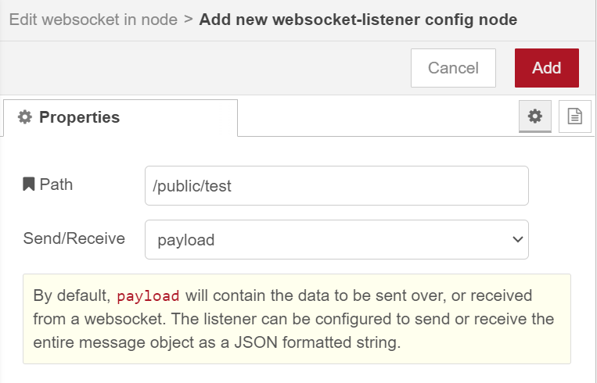
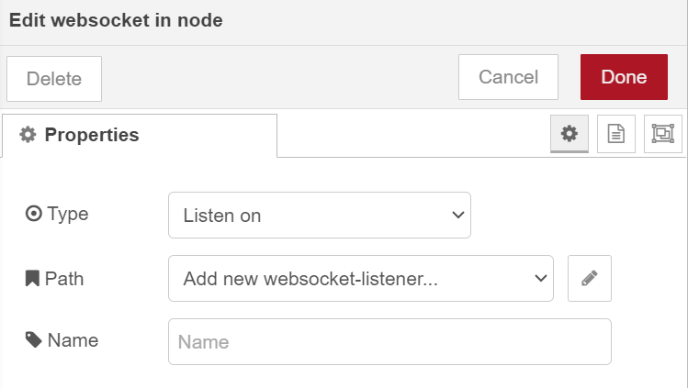
Step3: Add “websocket in”
5
1. Double click
4. /public/test
2. Listen on
3. Add new

Slide 9
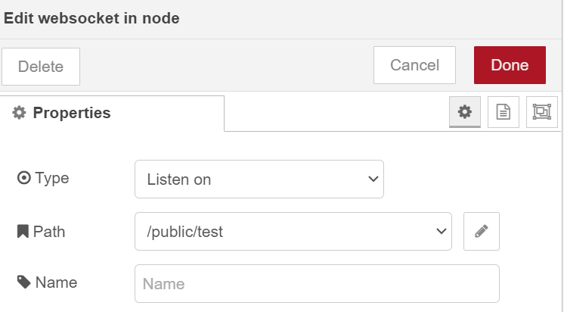

6

Slide 10
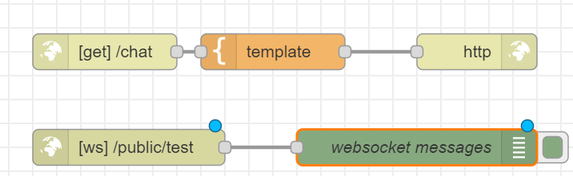

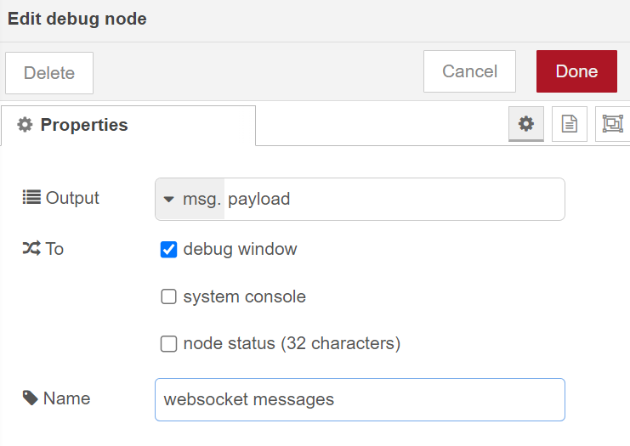
Step 4: Add a debug node

Slide 11
WebSocket Flow
WebSocket Server Listening
Show the messages on the debug window

Slide 12
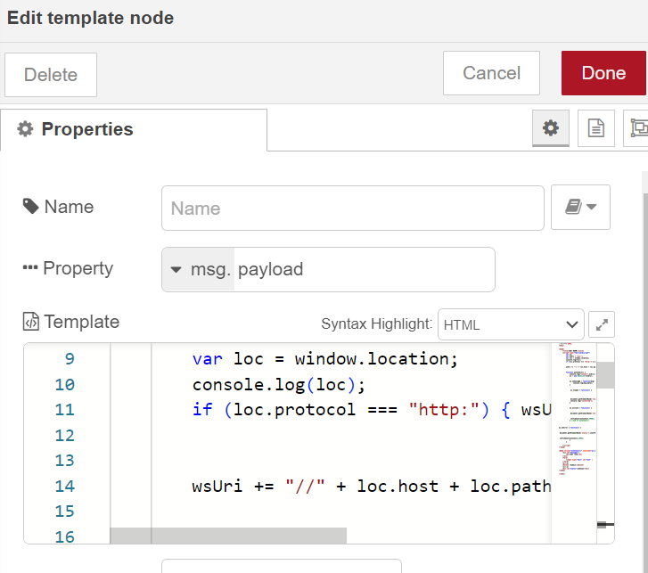

Step 5: Modify HTML
ex6-1-2.txt

Slide 13
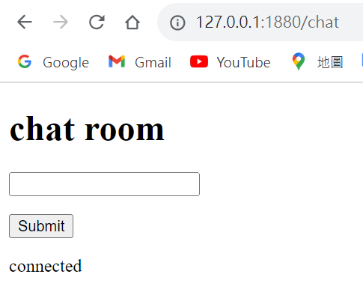
Step 6: Refresh the chat room web page
connected

Slide 14
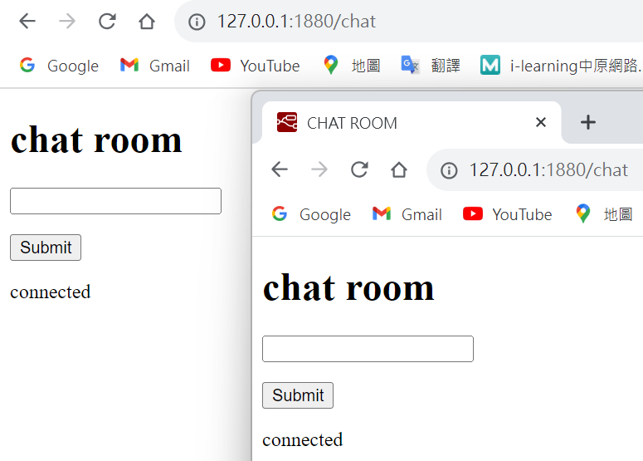
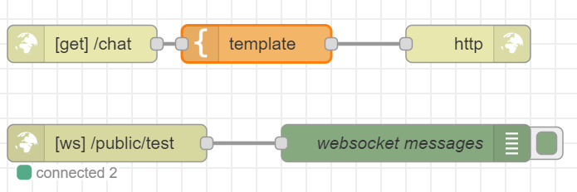
Step 7: Open the chat room web page in new window
connected2

Slide 15
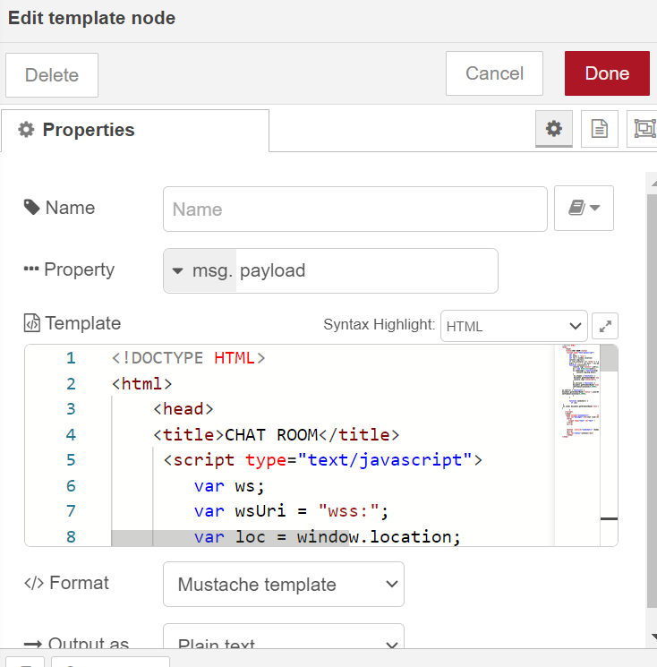
Step 8: Modify HTML
ex6-1-3.txt

Slide 16
Step 9: Refresh chat room web pages

Slide 17
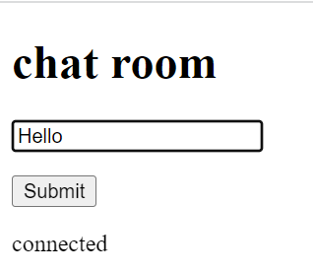
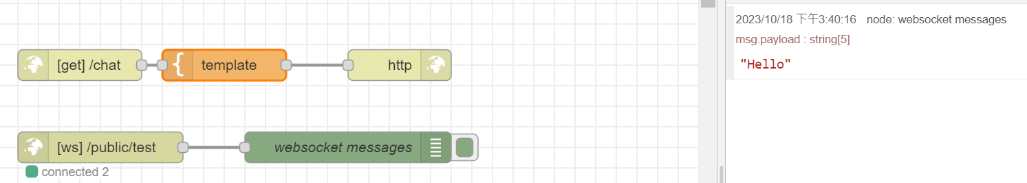
Step 10: Submit a message
1.Hello
2.Submit
Step 11: Check the debug window
Hello

Slide 18
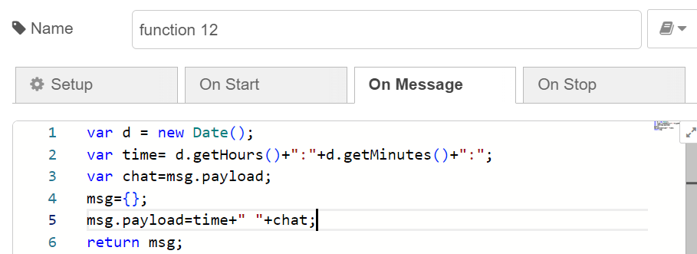
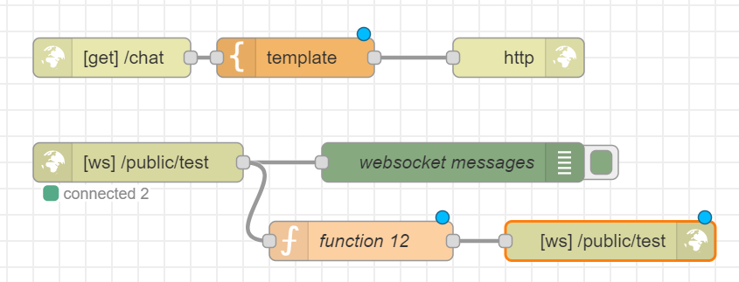
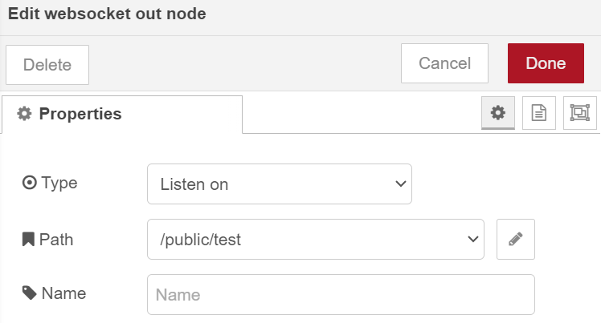
Step 12: Add a “function” node and a “websocket out” node

Slide 19
Flow
WebSocket Server Listening
Message processing
Broadcast via WebSocket Server

Slide 20
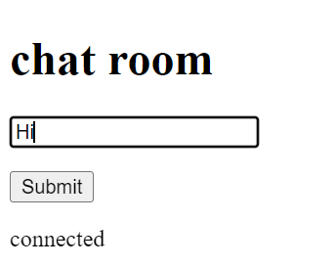
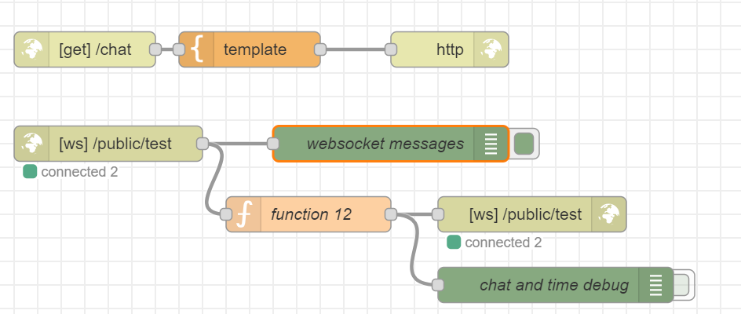
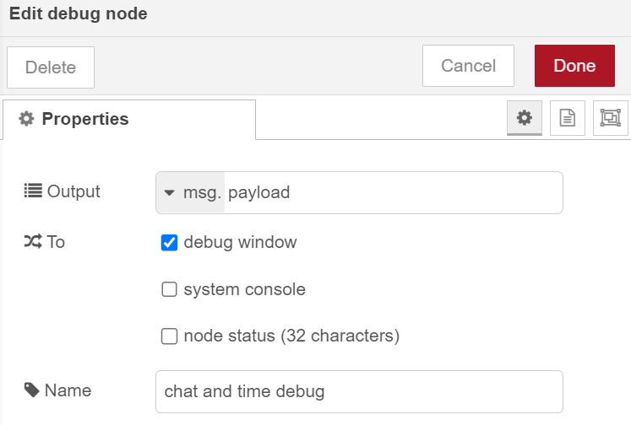
Step 13: Add a debug node

Slide 21
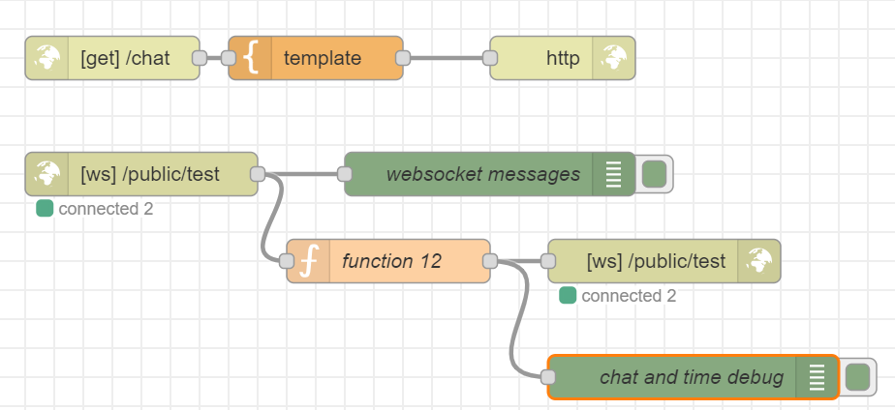
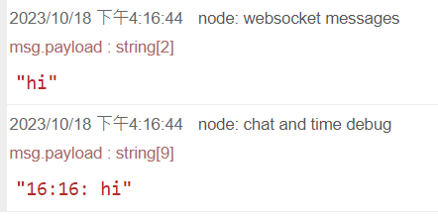
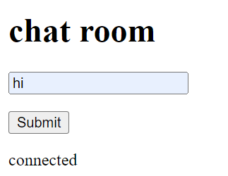
chat and time message
1.Hi
2.Submit

Slide 22
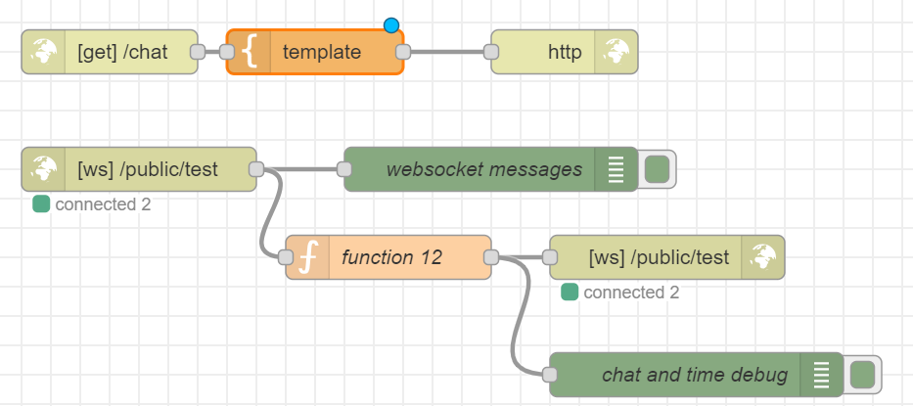
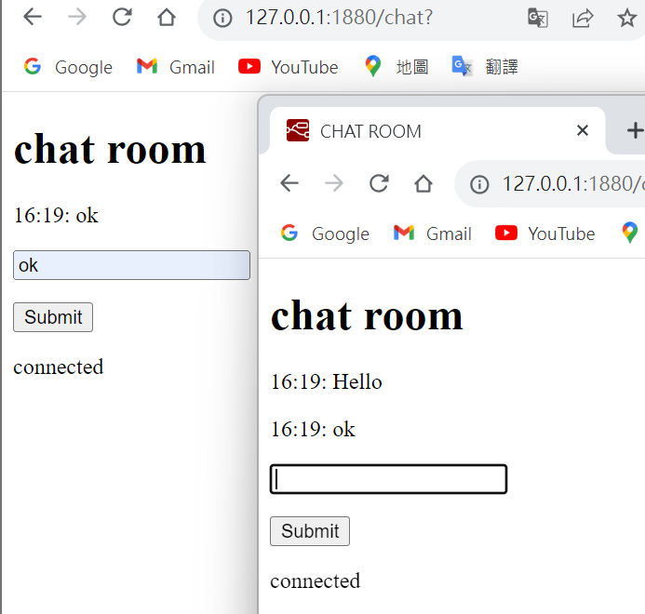
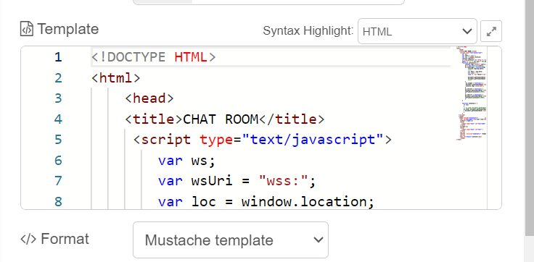
Step 15: Modify HTML
Result

Slide 23
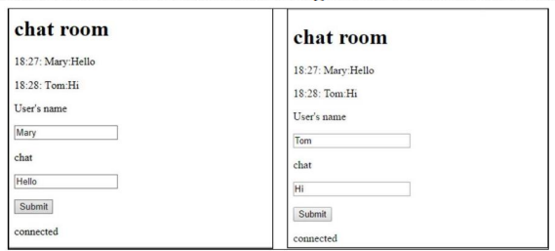
Homework 6-1
請加上一個可以輸入用戶端代號的文字表單，讓聊天室網頁呈現進 行聊天者的代號、聊天內容與聊天時間，如下圖所示。 Please add another input for user’s name. When you receive or send a message, show the time, the user’s name and the chat messag

Slide 24
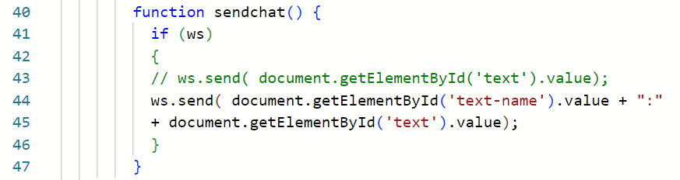
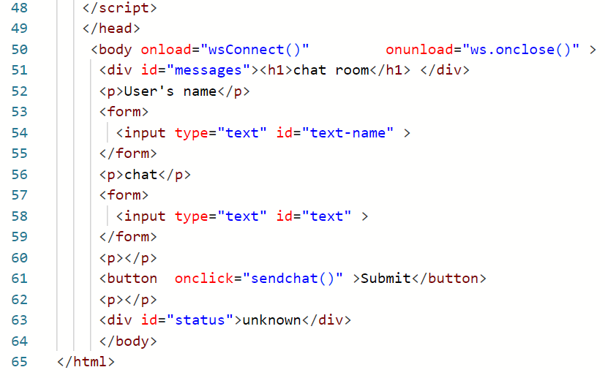
修改程式碼
增加使用者名字顯示跟一個冒號將人名文字區隔開來
增加一個User’s name跟chat的文字以及一個輸入框並給其一個id(text-name)用來記錄輸入的人名

Slide 25
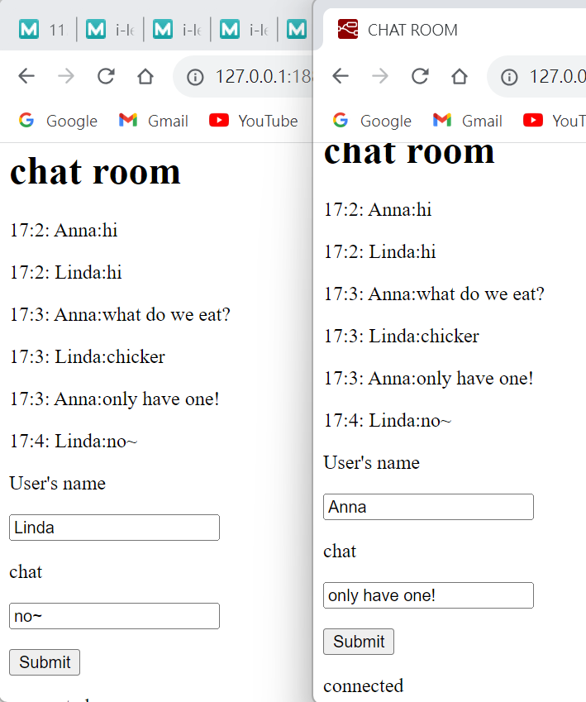
Result
Linda and Anna chat records

